Slide 1

Chatbot for supporting students at FHNW
C. Schmid, S. Drabert, C. Vogel & F. Polin

Slide 2
What is the objective of our project?
Experiment on a solution design for the automated answering of course related questions from students
Solution that supports students
without requiring the attention of the teacher
24/7 (immediate answer)
Proof of concept for further development of automated student support
Notes:
Experiment on a solution design for the automated answering of course related questions from students
Support provided to students
without requiring the attention of the teacher
24/7 no time delays (immediate answer)
Proof of concept for further development of automated student support

Slide 3
Why our project is appropriate?
Going towards digital transformation of FHNW
Complexity level justifies the use of Agile
Two languages (DE & EN)
Need to use large amounts of data
Machine learning
Knowledge engineering

Slide 4
Stacey Matrix: Is the WHO defined?
Team
Friedrich Witschel (teacher of BI course)
Project coach
Other? (e.g. students of BI course, external help)

Slide 5
Stacey Matrix: What about the WHAT?
A solution …
… to provide answers to questions related to the Business Intelligence course
… that allows student to get answers in a quick and efficient way
… that is available all the time
… that relieves teachers from having to respond to every student question
… that is automated so as to permit 24/7 support

Slide 6
Stacey Matrix: How?
Analyze the Question-to-Answer process
Gather required course related knowledge in Q&A form (documented knowledge)
Translate into Natural Language Processing (NLP)
Combination of knowledge engineering and machine learning for …
… correct and self-developing Chatbot solution (the more data the more effective)
Notes:
… analyze the Question-to-Answer process
… Gather required course related knowledge in Q&A form (documented knowledge)
… Translate the Q&A into Natural Language Processing (NLP)
… use a combination of knowledge engineering and Machine learning for correct and self-developing Chatbot solution (The more data the more effective)

Slide 7
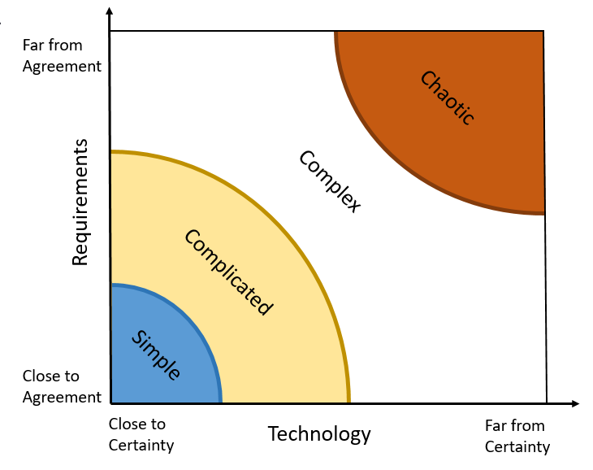
Sooo? Where are we? (Stacey Matrix)
Somewhere here

Slide 8
What is the situation? Why is a solution needed?
Currently no solution
Answer every individual question per E-Mail
Time consuming for teacher and unfair for students
Notes:
Currently there are no chatbot solution that the students can
use to get answers to their questions in a quick and effective manner
The teacher (already quite busy because he’s a teacher) needs to
take additional time to try and answer every question he receives from his students.
As the teacher is usually unable, due to time constraints, to answer every student
question and with the same amount of dedication, a quite unfair situation is the result:
Some students get answered and other not (plus, varying quality of answers)
The teacher (who is the one giving grades, is already aware of some students’ weaknesses)

Slide 9
What are our expectations?
… Conversion of tacit knowledge into automated knowledge
… Machine learning (experiment with large amount of email data)
… Develop an mockup / prototype for a chatbot solution
… List up the requirements
Notes:
Experiment on the possibility to convert tacit knowledge into automated knowledge
Experiment on machine learning using the large amount of data available (collection of E-Mail exchanges between Students and Fredrich)
Develop an MVP (for lack of a better word) for a chatbot solution
Integrate this chatbot solution

Slide 10

Question & Discussion

